Slide 1


NJACK IITP
INTRODUCING
REACTJS
www.react.dev
MAY 2023

Slide 2

AGENDA
INTRODUCTION TO REACT
TOOLS AND SETUP
INSTALLING REACT
JSX
COMPONENTS IN REACT
STATES IN REACT

Slide 3
Introduction to React
React is javascript library used for creating web and native user interfaces (aka frontend framework)
Fast
Modular
Scalable
Flexible
Popular

Slide 4
Requirements
Knowledge of basic HTML and Javascript is a requirement
No prior knowledge of react or any libraries/frameworks required

Slide 5
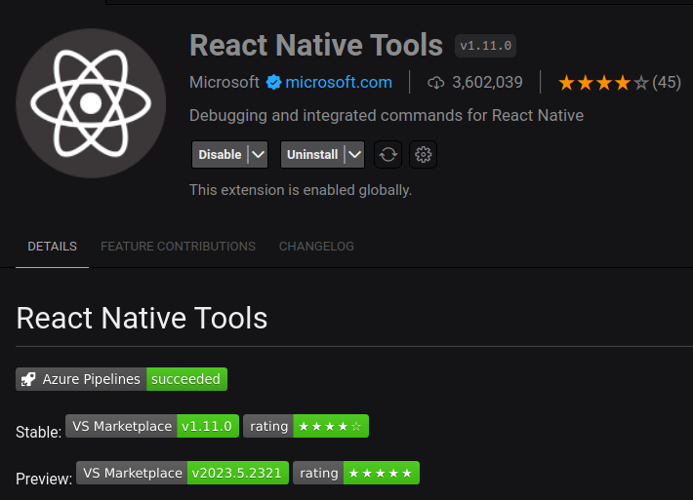
Set up tools
The required tools are:
VS Code (IDE)
Chrome/Firefox/Edge
Nodejs v12+
Extensions
ES7+ React/Redux/React-Native snippets

Slide 6
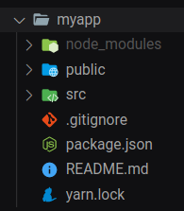
Installing React
To start a new react project, run the following commands in terminal
npm init -y
npx create-react-app myApp or yarn create react-app myapp
cd myapp
npm run start or yarn start
Note: React does not officially recommed create-react-app cli, but it is easier for beginners to learn. For production grade applications, use nextjs, gatsby, or remix, all of which are production ready frameworks.

Slide 7
Build Systems for React
Create-react-app configures a frontend build pipeline using Webpack module bundler, babel compiler, and ESLint code linter
While React can be used without a build pipeline, it is recommended to use one for productivity. A build pipeline consists of:
Package managers, like yarn or npm
Bundler, like Webpack or Browserify
Compiler like Babel (to support modern ES6 and JSX syntax)
To install only core react libraries, without the entire pipeline, run: npm i react react-dom or yarn add react react-dom
Another option is to use react by CDN
Using custom build systems are often important for production grade applications, so here is a guide to setting up a react build system: https://dev.to/ivadyhabimana/how-to-create-a-react-app-without-using-create-react-app-a-step-by-step-guide-30nl

Slide 8
JSX
The non-standard way of writing HTML and Javascript
JSX is a syntax extension for JavaScript that lets you write HTML-like markup inside a JavaScript file. Although there are other ways to write components, most React developers prefer the conciseness of JSX, and most codebases use it.
JSX and React are two separate things. They’re often used together, but you can use them independently of each other. JSX is a syntax extension, while React is a JavaScript library.

Slide 9
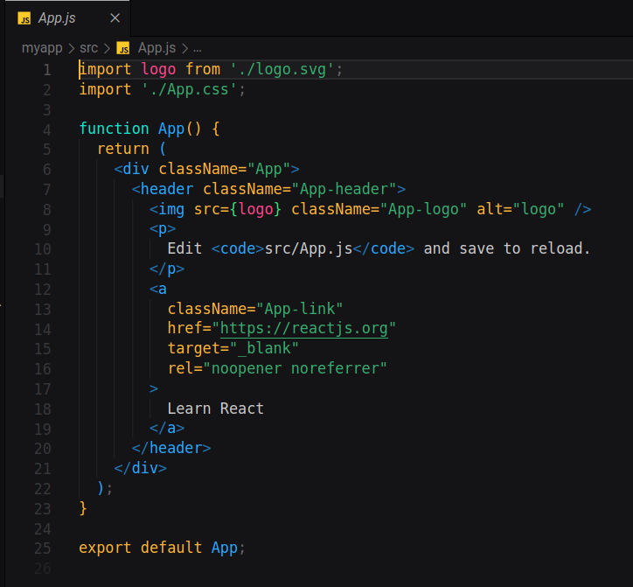
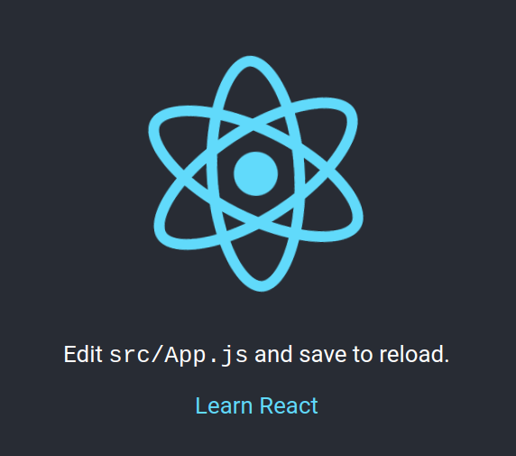

Slide 10
Rules of JSX
Return a single root element
Close all the tags
camelCase most of the things (class becomes className, stroke-width becomes strokeWidth, as javascript does not allow dashes in attribute names)
visit https://react.dev/learn/writing-markup-with-jsx#the-rules-of-jsx for details
Tip: Use a HTML to JSX converter to initially understand how JSX syntax works: https://transform.tools/html-to-jsx

Slide 11
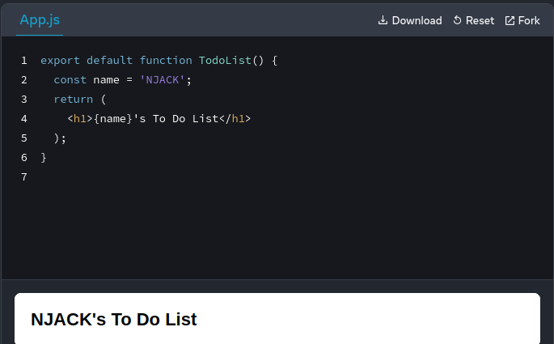
Javascript in JSX
Javascript statements can be inserted into JSX using curly brackets {}

Slide 12
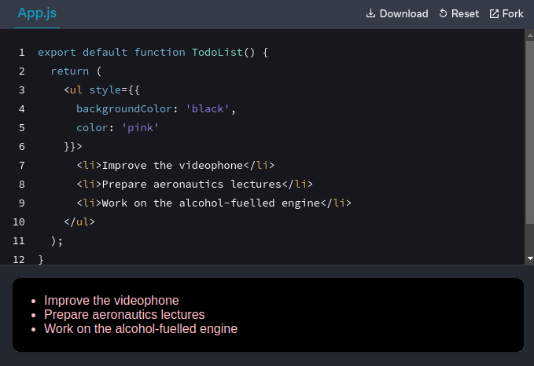
CSS in JSX
CSS statements can be inserted into JSX using double curly brackets {}, as they are represented as javascript objects.

Slide 13
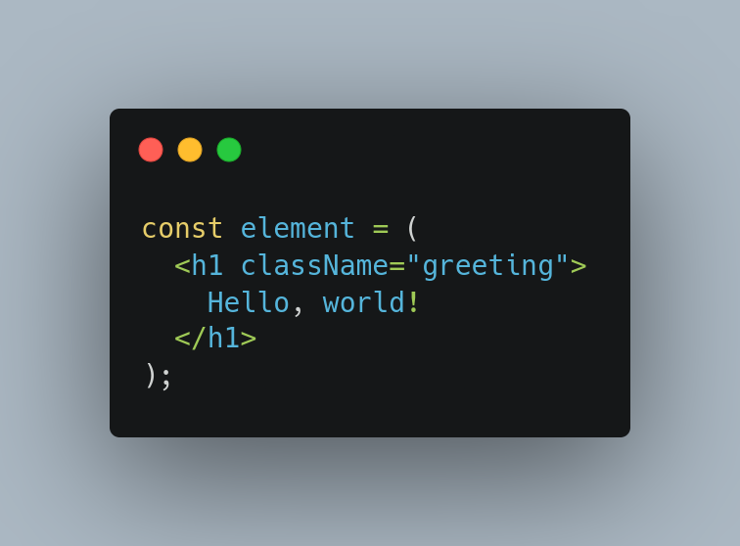
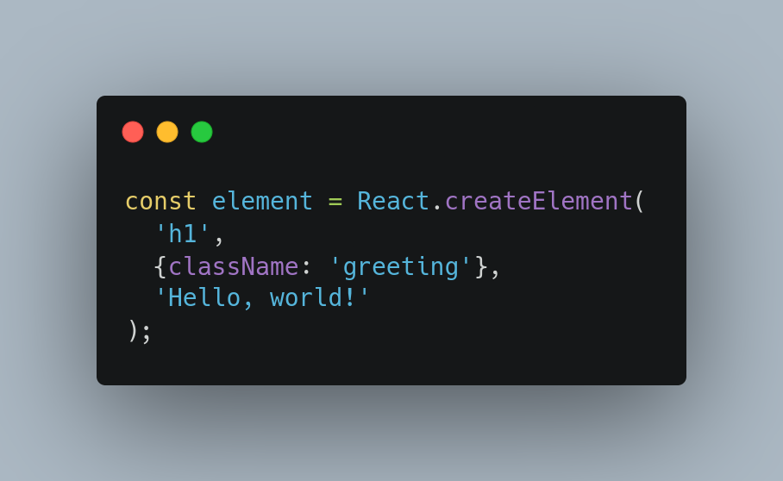
React can be used without JSX too

Slide 14
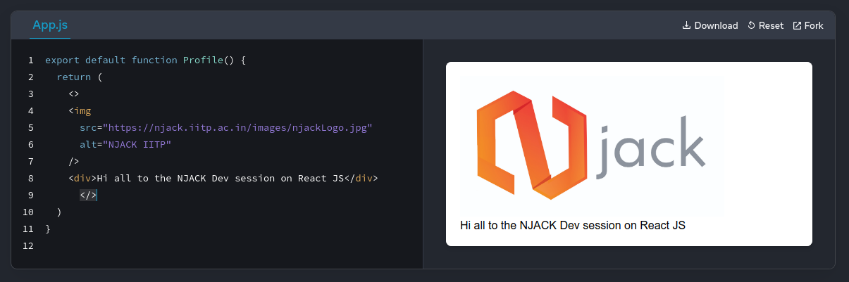
Components
Components are reusable UI elements for your App
In a React app, every piece of UI is a component.
React components are regular JavaScript functions except:
Their names always begin with a capital letter.
They return JSX markup.

Slide 15
Steps to build Component
Step1: Export the Component
The export default prefix is a standard JavaScript syntax (not specific to React). It lets you mark the main function in a file so that you can later import it from other files.
Step2: Define the function
With function Profile() { } you define a JavaScript function with the name Profile.
React components are regular JavaScript functions, but their names must start with a capital letter or they won’t work!
Step3: Add the markup
Add the JSX that needs to be returned. But if your markup isn’t all on the same line as the return keyword, you must wrap it in a pair of parentheses.

Slide 16
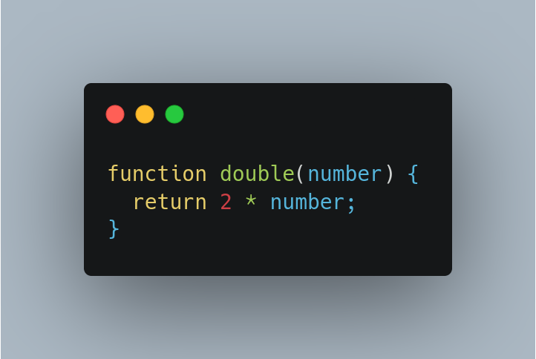
React components must be pure
A pure function is a function with following characteristics
It does not change any objects or variables that existed before it was called
Given the same inputs, a pure function should always return the same result
React is designed around this concept. React assumes that every component you write is a pure function. This means that React components you write must always return the same JSX given the same inputs

Slide 17
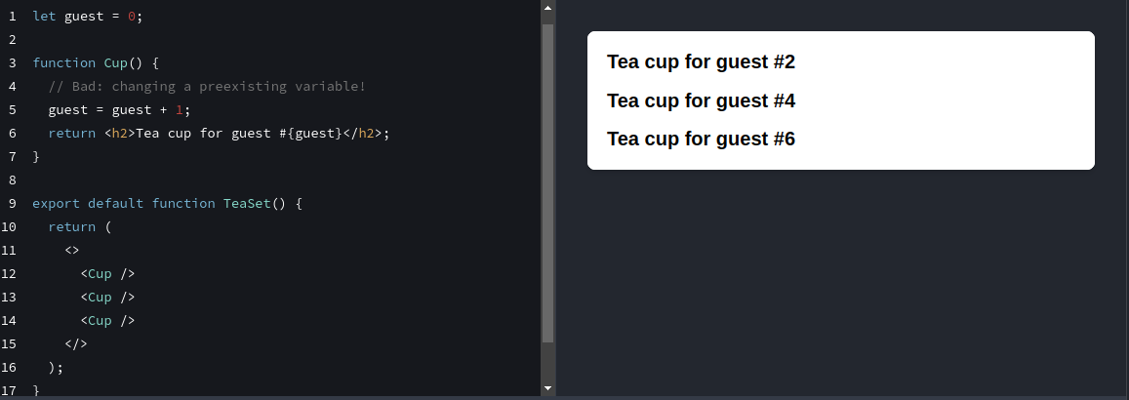
Example of impure component

Slide 18
Using React's "Strict Mode"
React's "Strict Mode" can be used to detect impure calculations during development.
React offers a “Strict Mode” in which it calls each component’s function twice during development. By calling the component functions twice, Strict Mode helps find components that break these rules.
There are ways in which we can update the render within a react component, which we will be discussing later.

Slide 19
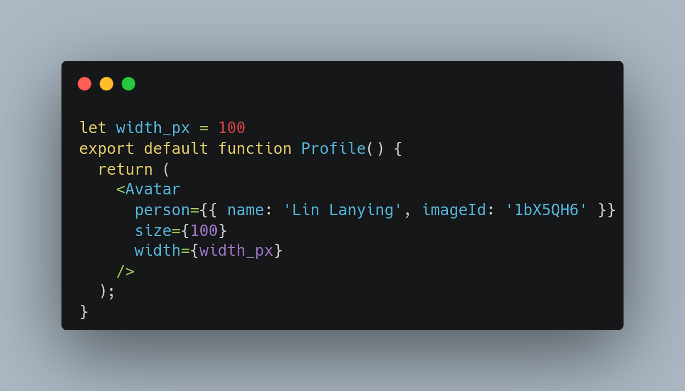
"props" in react
React components use props to communicate with each other. Every parent component can pass some information to its child components by giving them props. Props might remind you of HTML attributes, but you can pass any JavaScript value through them, including objects, arrays, and functions.

Slide 20
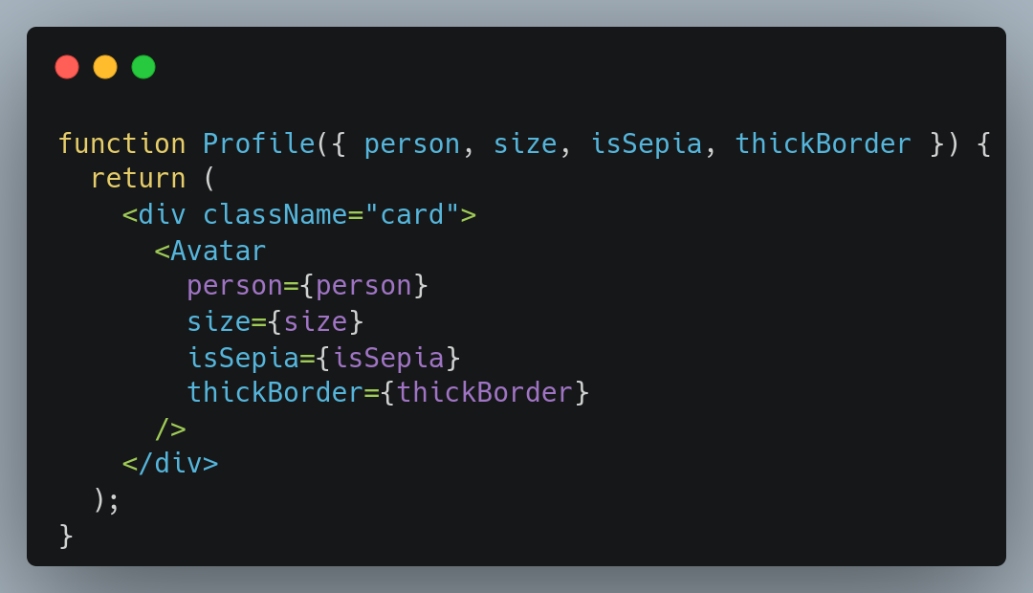
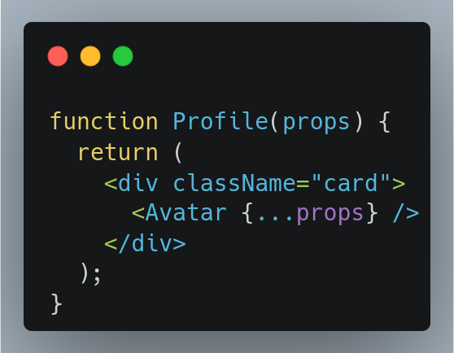
Forwarding props with the JSX spread syntax
Sometimes, passing props gets very repetitive:

Slide 21
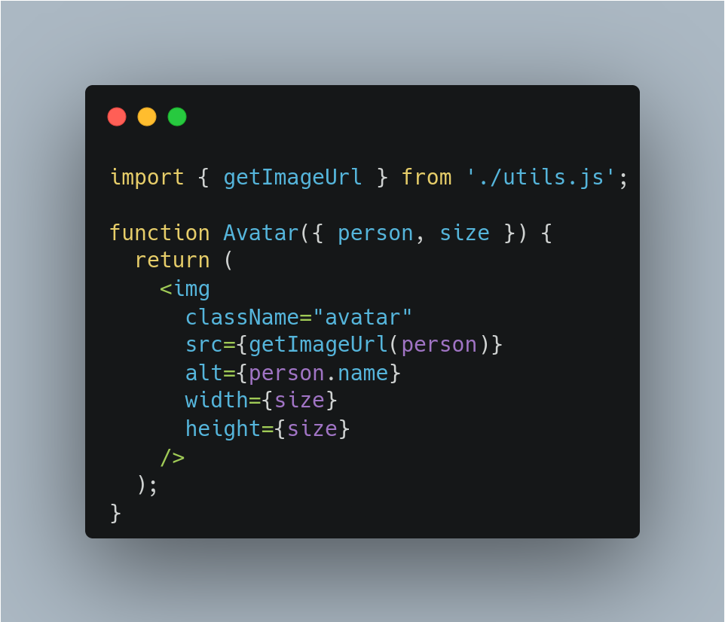
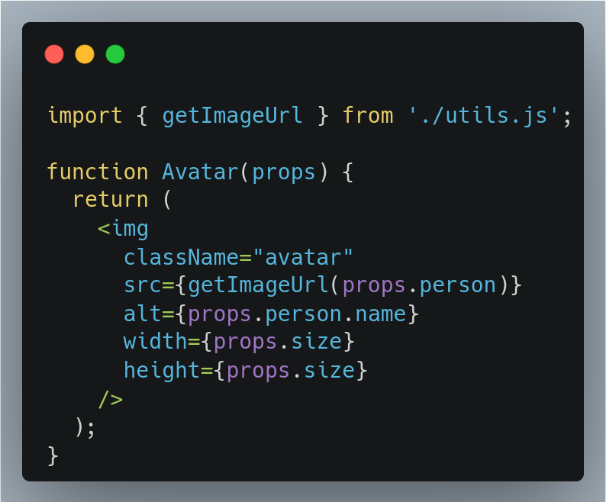
Reading props from child

Slide 22
Props changing over time
A component may receive different props over time. Props are not always static!
Props reflect a component’s data at any point in time, rather than only in the beginning.
However, props are immutable—a term from computer science meaning “unchangeable”. When a component needs to change its props (for example, in response to user interaction or new data), it will have to “ask” its parent component to pass it different props—a new object! Its old props will then be cast aside, and eventually the JavaScript engine will reclaim the memory taken by them.

Slide 23
Conditional Rendering
Your components will often need to display different things depending on different conditions. In React, you can conditionally render JSX using JavaScript syntax like if statements, &&, and ? : operators.

Slide 24
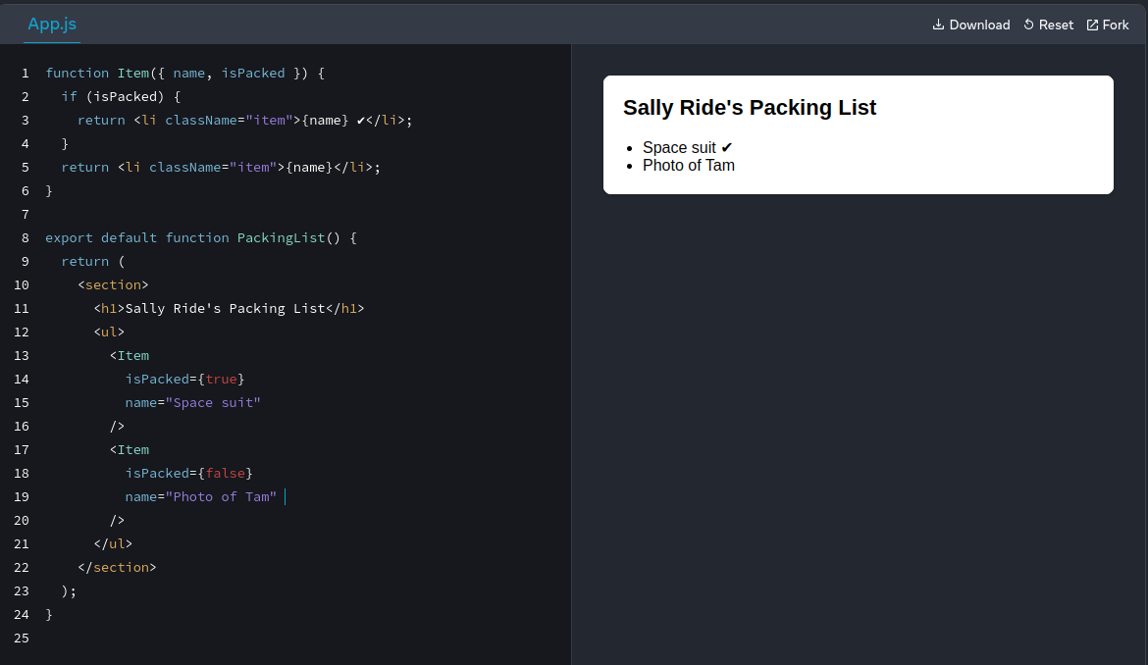
Conditional rendering using
if-else syntax

Slide 25
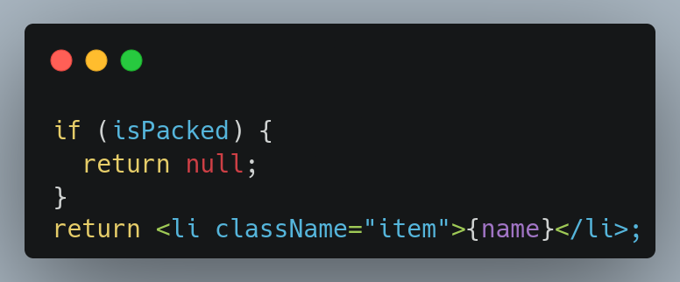
Sometimes we need to return nothing on some condition

Slide 26
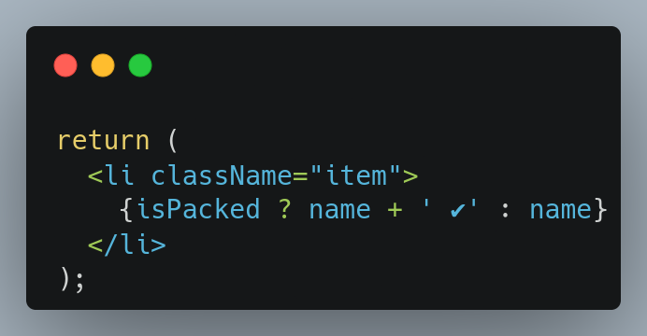
Using javascript ternary operator
You can read it as “if isPacked is true, then (?) render name + ' ✔', otherwise (:) render name”.

Slide 27
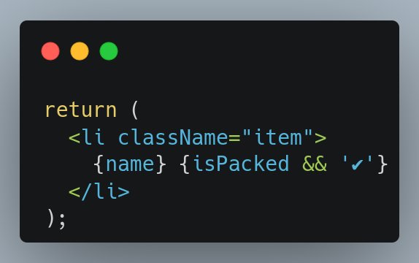
Using javascript && operator
You can read this as “if isPacked, then (&&) render the checkmark, otherwise, render nothing”.

Slide 28
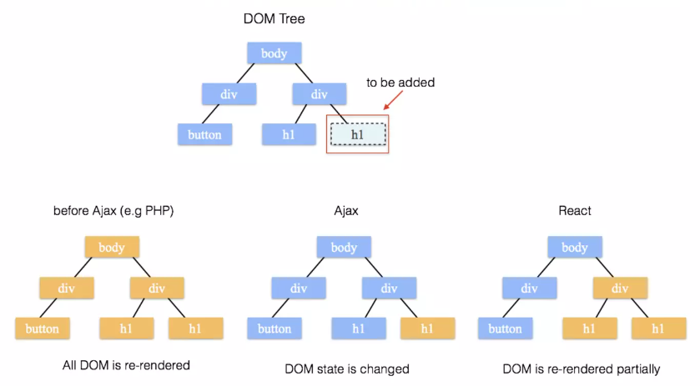
Updating a rendered element
React elements are immutable. Thus the only way to update a UI is to re-render the components entirely. React achieves this by creating a virtual-dom tree.

Slide 29
React virtual dom tree
React only updates what's necessary
React only updates DOM elements that have changed. This means if we re-render a component twice in a row, the second render will do nothing.
React uses a heuristic diffing algorithm to find out portions of the virtual dom that has been updated, which has the complexity of O(n), while state-of-the-art algorithms have O(n^3) complexity.
Read more: https://legacy.reactjs.org/docs/reconciliation.html

Slide 30
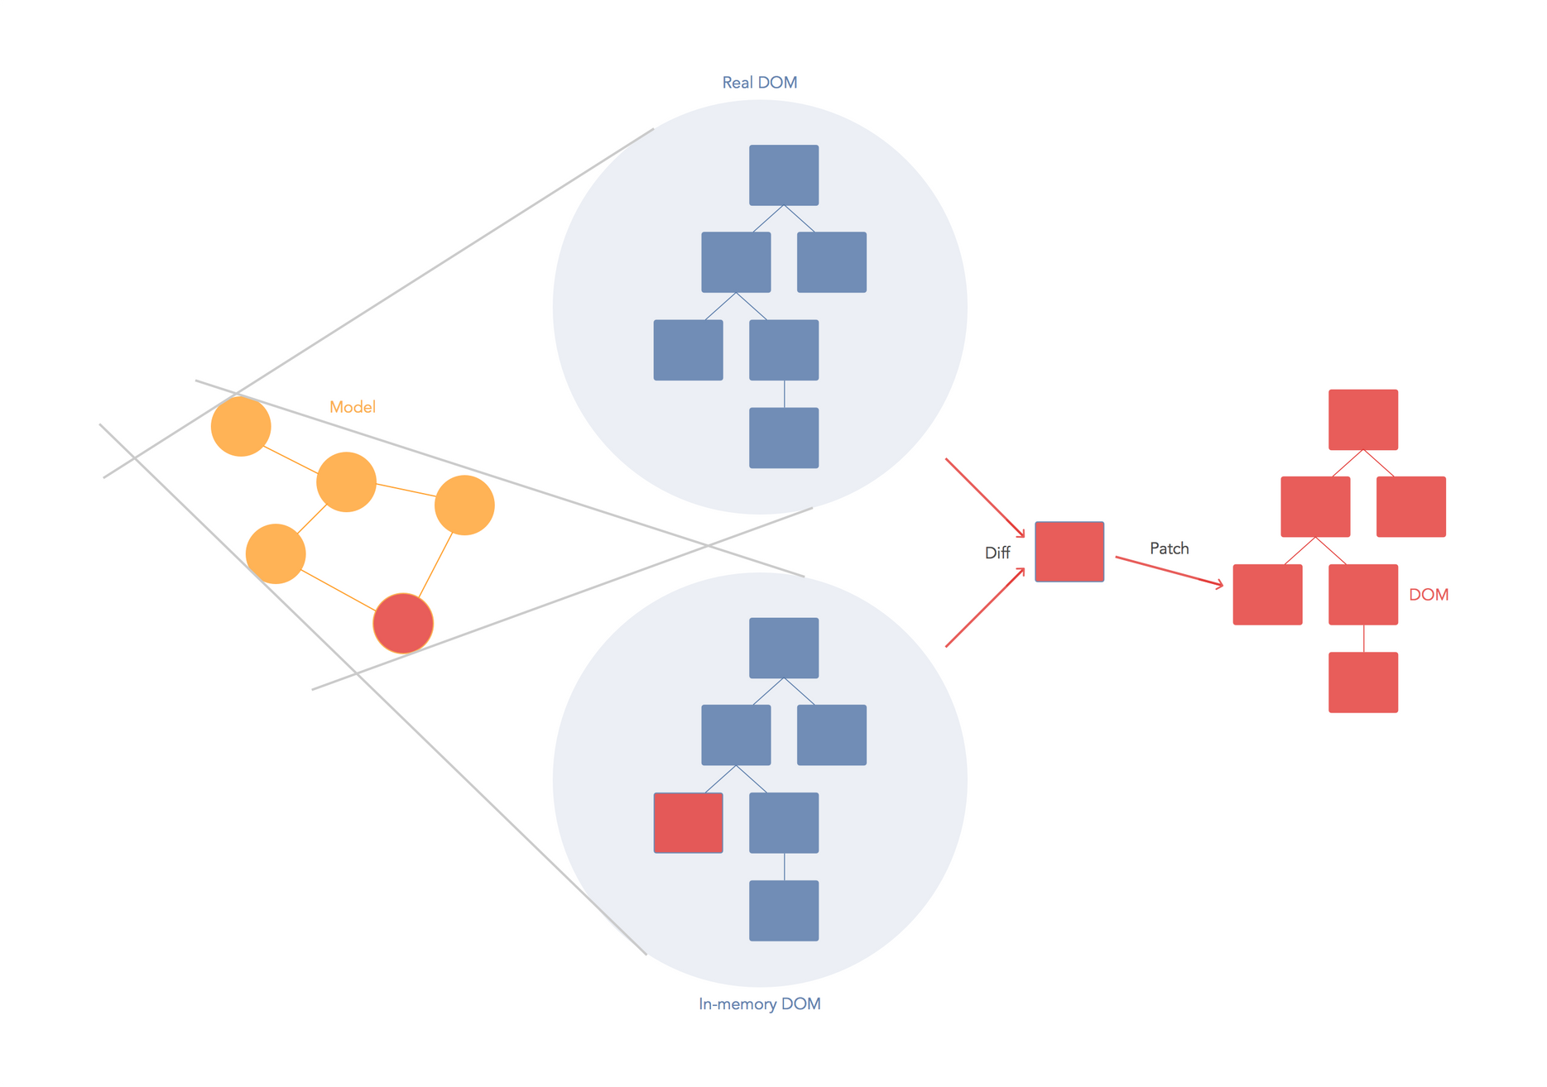

Slide 31
States in React
React provides a declarative way to manipulate the UI. Instead of manipulating individual pieces of the UI directly, you describe the different states that your component can be in, and switch between them in response to the user input.
How to create UI with states in React
Identify your component’s different visual states
Determine what triggers those state changes
Represent the state in memory using useState
Remove any non-essential state variables
Connect the event handlers to set the state

Slide 32
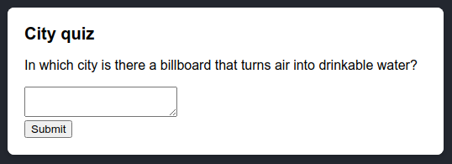
Step 1: Identify your component’s different visual states
First, you need to visualize all the different “states” of the UI the user might see:
Empty: Form has a disabled “Submit” button.
Typing: Form has an enabled “Submit” button.
Submitting: Form is completely disabled. Spinner is shown.
Success: “Thank you” message is shown instead of a form.
Error: Same as Typing state, but with an extra error message.

Slide 33
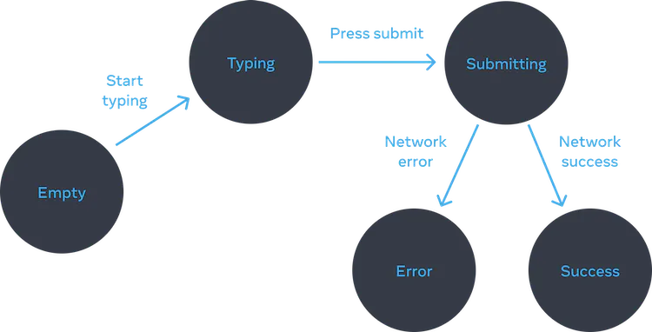
Step 2: Determine what triggers those state changes
You can trigger state updates in response to two kinds of inputs:
Human inputs, like clicking a button, typing in a field, navigating a link.
Computer inputs, like a network response arriving, a timeout completing, an image loading.
To help visualize this flow, try drawing each state on paper as a labeled circle, and each change between two states as an arrow. You can sketch out many flows this way and sort out bugs long before implementation.

Slide 34
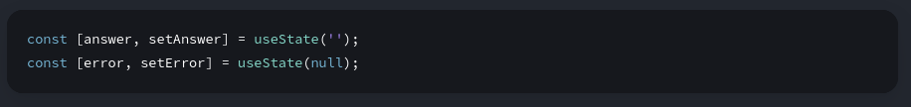
Step 3: Represent the state in memory with useState
Next you’ll need to represent the visual states of your component in memory with useState. Simplicity is key: each piece of state is a “moving piece”, and you want as few “moving pieces” as possible. More complexity leads to more bugs!
Start with the state that absolutely must be there. For example, you’ll need to store the answer for the input, and the error (if it exists) to store the last error:
Then, you’ll need a state variable representing which one of the visual states that you want to display. There’s usually more than a single way to represent that in memory, so you’ll need to experiment with it.

Slide 35
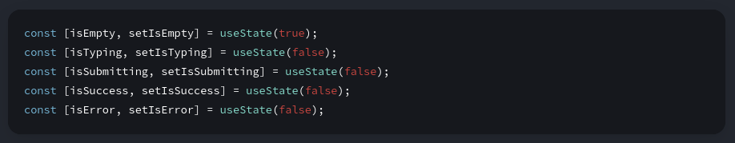
If you struggle to think of the best way immediately, start by adding enough state that you’re definitely sure that all the possible visual states are covered:
Your first idea likely won’t be the best, but that’s ok—refactoring state is a part of the process!

Slide 36
Step 4: Remove any non-essential state variables
You want to avoid duplication in the state content so you’re only tracking what is essential. Spending a little time on refactoring your state structure will make your components easier to understand, reduce duplication, and avoid unintended meanings.
Here are some questions you can ask about your state variables:
Does this state cause a paradox? For example, isTyping and isSubmitting can’t both be true. A paradox usually means that the state is not constrained enough. There are four possible combinations of two booleans, but only three correspond to valid states. To remove the “impossible” state, you can combine these into a status that must be one of three values: 'typing', 'submitting', or 'success'.

Slide 37
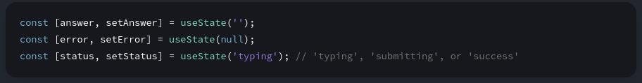
Is the same information available in another state variable already? Another paradox: isEmpty and isTyping can’t be true at the same time. By making them separate state variables, you risk them going out of sync and causing bugs. Fortunately, you can remove isEmpty and instead check answer.length === 0.
Can you get the same information from the inverse of another state variable? isError is not needed because you can check error !== null instead.
After this clean-up, you’re left with 3 (down from 7!) essential state variables:

Slide 38
Step 5: Connect the event handlers to set state

Slide 39
Some suggestions regarding states
Group related state. If you always update two or more state variables at the same time, consider merging them into a single state variable.
Avoid contradictions in state. When the state is structured in a way that several pieces of state may contradict and “disagree” with each other, you leave room for mistakes. Try to avoid this.
Avoid redundant state. If you can calculate some information from the component’s props or its existing state variables during rendering, you should not put that information into that component’s state.
Avoid duplication in state. When the same data is duplicated between multiple state variables, or within nested objects, it is difficult to keep them in sync. Reduce duplication when you can.
Avoid deeply nested state. Deeply hierarchical state is not very convenient to update. When possible, prefer to structure state in a flat way.

Slide 40
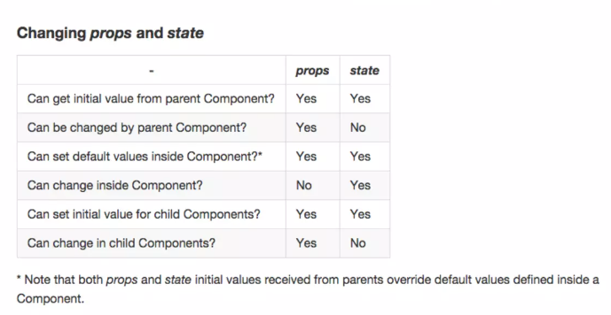
Props vs state

Slide 41
Live Demo
Simple TODO App with CRUD functionality

